Slide 1
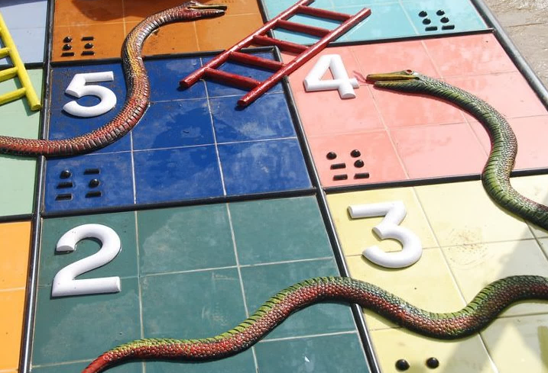

Chutes and Ladders:
Winning in the Global Trade Game
Barry Draskovich
Group Vice President
Program and Contracts Management
Parker Aerospace
Orange County World Trade Week Breakfast & Forum 2017

Slide 2
Parker Hannifin: a global importer - exporter
Chutes and ladders: the risks and opportunities of global trade
The current global trade environment
Why get into this tricky game?
Lessons learned
Tools for success
Agenda:
an overview
of the game
2

Slide 3
Parker Hannifin: a global importer - exporter
Chutes and ladders: the risks and opportunities of global trade
The current global trade environment
Why get into this tricky game?
Lessons learned
Tools for success
Agenda:
an overview
of the game
3

Slide 4

PARKER HANNIFIN
1917-2017
A century of
innovation
4

Slide 5
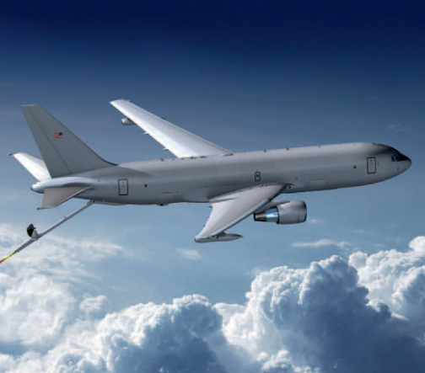


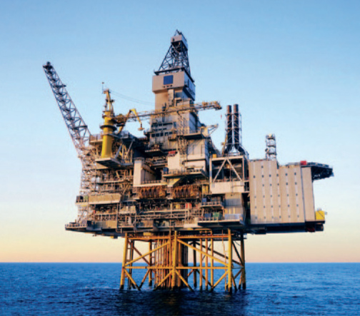

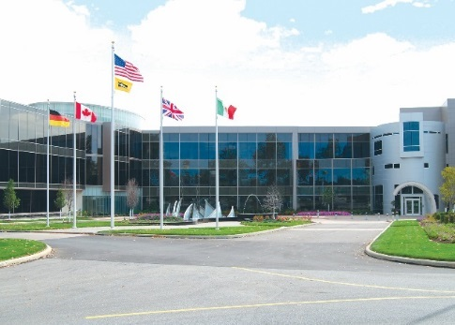
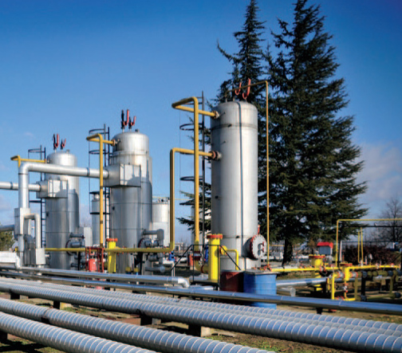
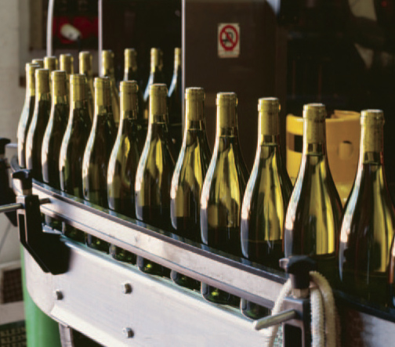
PARKER HANNIFIN
    $11.4 billion in sales
Parker Hannifin Corporation
A worldwide, diversified manufacturer of motion and control systems and technology
    49,000
    employees
    292 global
    manufacturing facilities
5

Slide 6
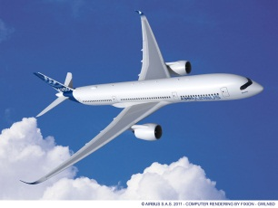
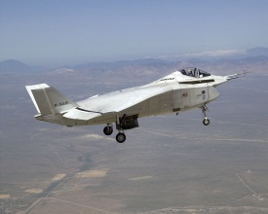
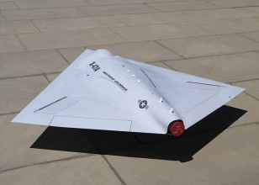
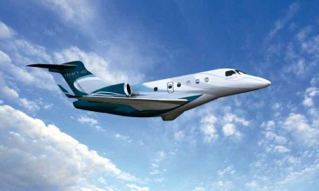
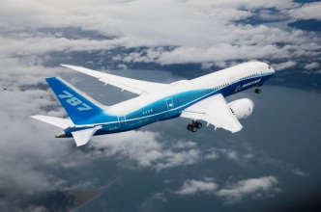
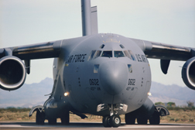
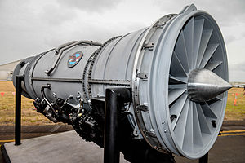
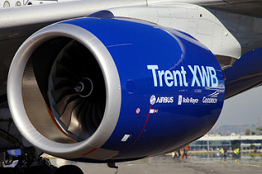
PARKER HANNIFIN
Seven divisions,
38 worldwide locations
Parker Aerospace
A global leader in systems
and components
• Flight control actuation
• Hydraulics
• Fuel and inerting
• Fluid conveyance
• Pneumatics
• Lubrication
$2.3 billion
in annual sales
5,700 employees
(1,086 engineers)
6

Slide 7
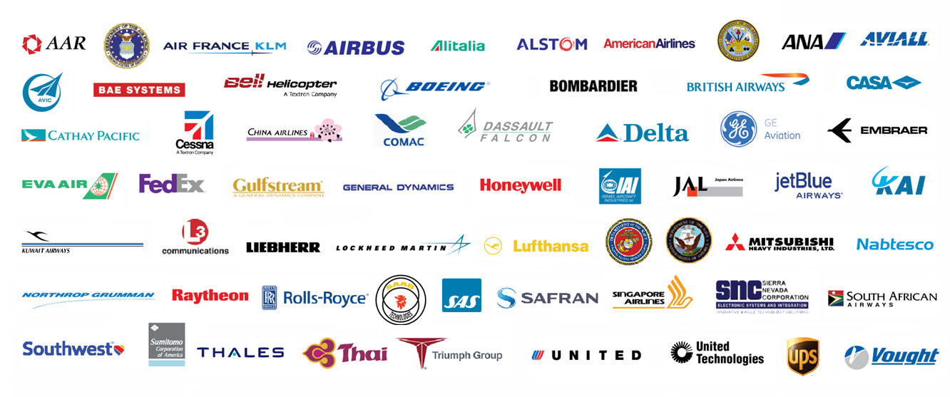






PARKER HANNIFIN
Supporting the world’s fleet
Commercial and military aircraft and their engines
7

Slide 8
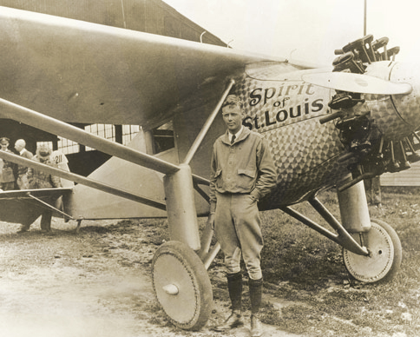
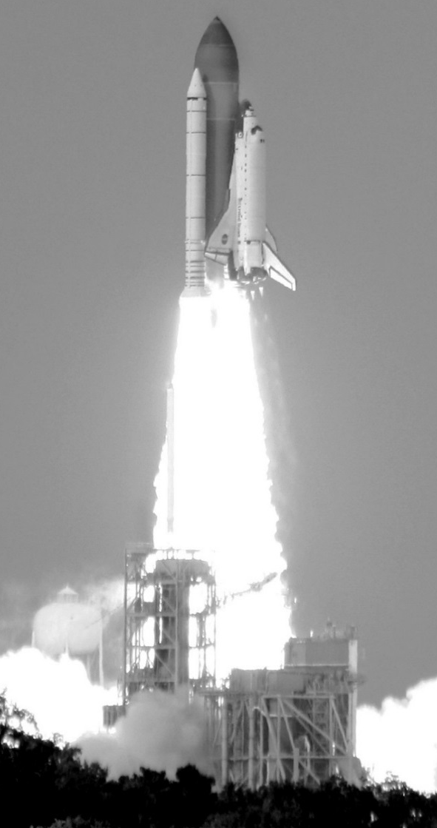
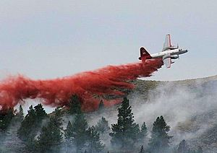
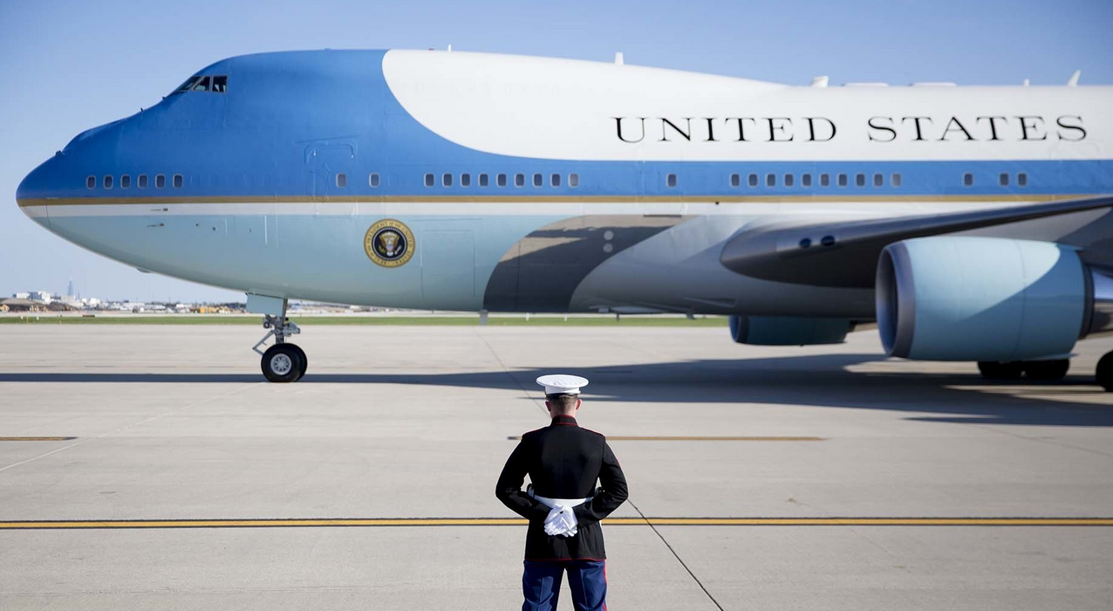
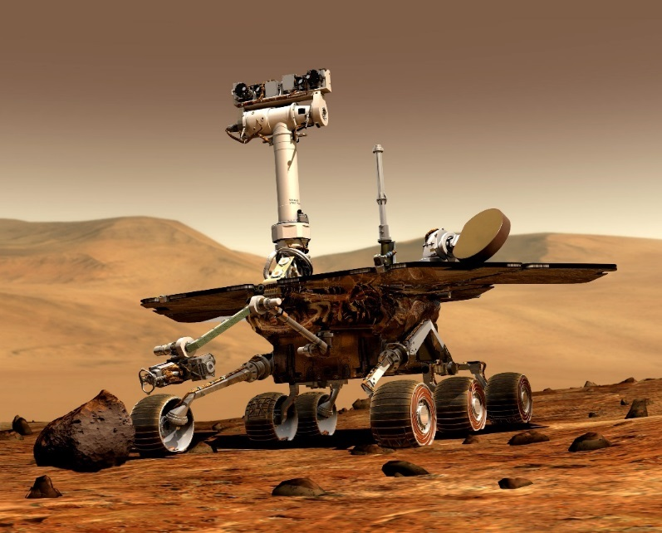

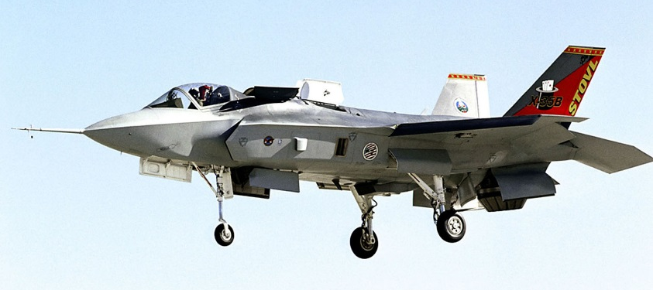

PARKER HANNIFIN
A long history of exports & business _ international & interplanetary
8
Notes:
He was counseled to bring a second man as a relief pilot, so they could take turns sleeping, and a navigator. Lindbergh replied, “I’ve thought about it a good deal. I believe the chances for success are better with one pilot than with two. I’d rather have extra gasoline than an extra man.”
He was a fanatic on reducing weight to conserve fuel. When asked if he was going to bring along a parachute, Lindbergh replied, “No, that would cost almost 20 pounds.”
Lindbergh had asked his friends Glenn Martin and Donald Douglas about the Parker Appliance Co., and both vouched for the quality of its design and manufacturing processes. Hall, who had worked closely with Douglas at his Santa Monica plant, readily agreed with Lindbergh’s request to take a closer look at Parker’s fuel distribution system. At Hall’s request, Mahoney send a letter to Art asking him to design a fuel distribution system that could handle the 3,000 pounds of fuel that would be on board the Spirit of St. Louis when it took off for Paris.

Slide 9
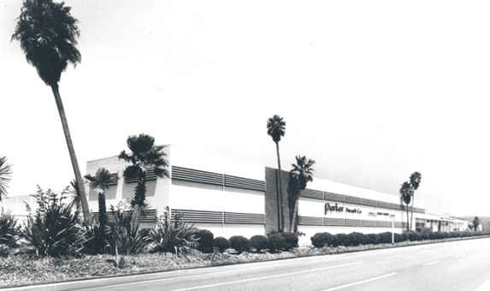
PARKER HANNIFIN
Parker in Southern California
Home to the booming aviation industry
in the ‘50s
Los Angeles / Century Boulevard
9

Slide 10
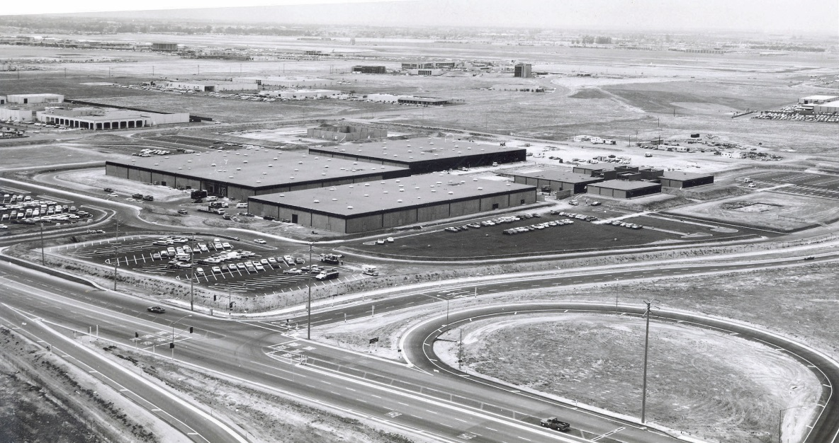
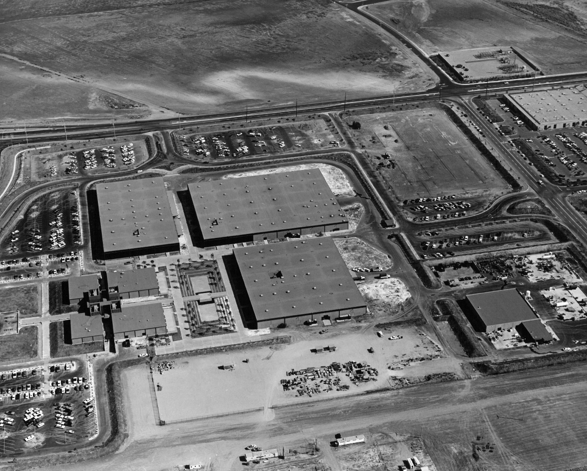

390,000-square-foot group of buildings on 42 acres in undeveloped Orange County, next to the brand-new 405 freeway
10
PARKER HANNIFIN
Parker in Southern California
Land swap with the Marriott hotel in the ‘60s
Irvine / Jamboree Boulevard
10
Notes:
In the late 1960s, The Marriott Hotel group wanted to built a hotel near LAX.
Parker Aerospace wanted to be able to grow and develop in an community with a low cost of living for its employees
Parker traded its LA property for a 75-acre plot owned by the Marriott Corporation in undeveloped Orange County. As part of the trade, Marriott agreed to build a manufacturing and office complex for Parker on the site.
In 1971, Parker Aerospace moved into the 390,000-square-foot group of buildings on Jamboree Boulevard in the city of Irvine, next to the San Diego freeway, which was still under construction at the time. The company occupied 42 acres.
Marriott tore down the Century City property and built a multistory hotel to serve the growing needs of the LAX community.

Slide 11
PARKER HANNIFIN
Parker in Southern California
A new plant on Alton Parkway in 1985
350,000-square-foot facility on 60 acres, headquarters for Parker’s Control Systems Division and Customer Support Operations
11

Slide 12
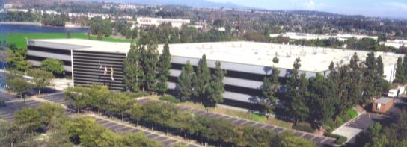
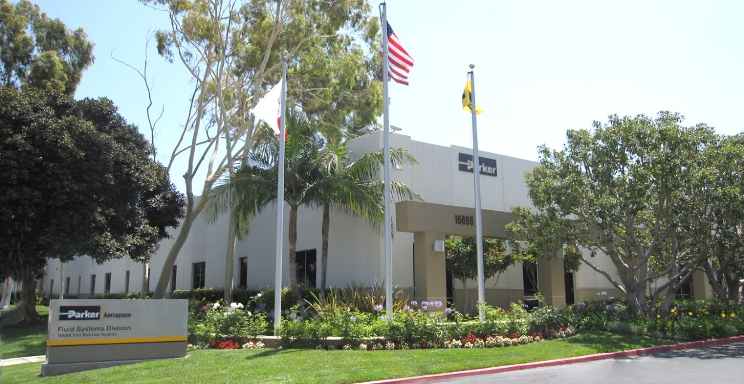
PARKER HANNIFIN
Parker in Southern California
Parker in Irvine today
1,700+ employees
550,000 square feet of manufacturing and office space
$675M in annual sales
576 California first-tier suppliers
$406M in purchases from local suppliers
Headquarters for Control Systems Division and Customer Support Operations
14300 Alton Parkway — 1,135 employees, 350,000 square feet
Headquarters for Fluid Systems Division
16666 Von Karman Avenue — 570 employees, 200,000 square feet
12

Slide 13

Parker Hannifin: a global importer - exporter
Chutes and ladders: the risks and opportunities of global trade
The current global trade environment
Why get into this tricky game?
Lessons learned
Tools for success
13

Slide 14




CHUTES & LADDERS
Chutes and ladders: a game of both skill and luck
“Snakes and Ladders” played since the 19th century in
India and
England
LADDERS - Opportunities for you to succeed
CHUTES - Risks that may set you back
14

Slide 15
Parker Hannifin: a global importer - exporter
Chutes and ladders: the risks and opportunities of global trade
The current global trade environment
Why get into this tricky game?
Lessons learned
Tools for success
15

Slide 16
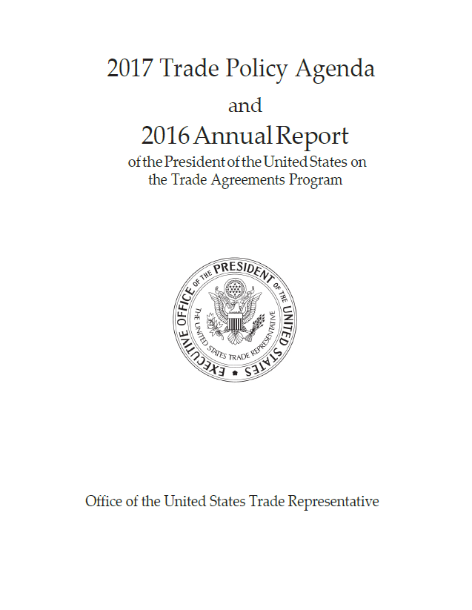

GLOBAL TRADE ENVIRONMENT
Defending our national sovereignty over trade policy: WTO Dispute Settlement Understanding vs. U.S. law or practice
Strictly enforcing U.S. trade laws: “dumping” and our ability to impose relief
Using leverage to open foreign markets: free-market principles vs. foreign protectionist policies
Negotiating new and better trade deals: bi-lateral vs. multi-lateral; NAFTA, TPP, etc.?
Free and fair trade
What we might expect
16

Slide 17

GLOBAL TRADE ENVIRONMENT
A major focus of the Trump administration
  Net reduction in overall corporate taxes
  Pay-for might be tax loophole modification, border adjustment
    Importers may pay more taxes
    Exporters may pay less
What’s next?
  Is legislation on the horizon?
  What will it look like?
Repatriation of stranded earnings
Tax reform and when it might happen
17

Slide 18
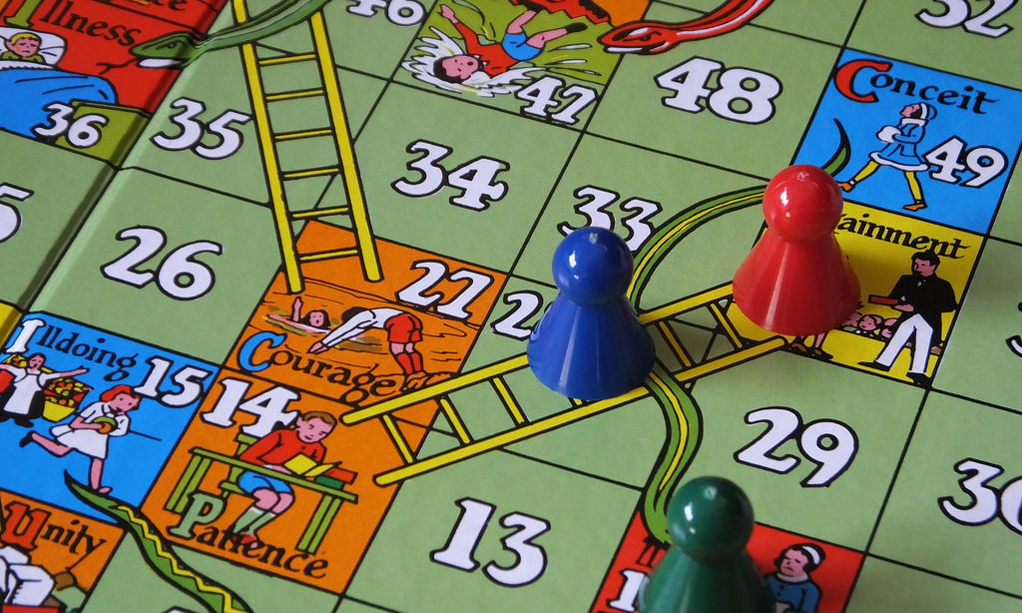
GLOBAL TRADE ENVIRONMENT
Who can predict which way this is going?
This game is unpredictable
Provides both threats and opportunities
Buckle up for an exciting ride . . .
18

Slide 19
Parker Hannifin: a global importer - exporter
Chutes and ladders: the risks and opportunities of global trade
The current global trade environment
Why get into this tricky game?
Lessons learned
Tools for success
19

Slide 20
20
WHY GET INTO THIS TRICKY GAME?
What is your motivation?
Understand your motivation.
Is it rational or emotional?
Increased sales/profits?
Tax advantages?
The excitement and sophistication of being in the global market?
The opportunity to travel internationally and write it off?
Limited growth opportunities in the US?
20

Slide 21
21
WHY GET INTO THIS TRICKY GAME?
What will you sell and who will you sell to?
Understand your customers
and their customs
Understand your market
  Is there a need for your product? Be honest.
  Is there competition? Who and how strong?
  Are there US/foreign regulatory limits that
  need to be considered?
  Do you know the foreign environment?
21

Slide 22
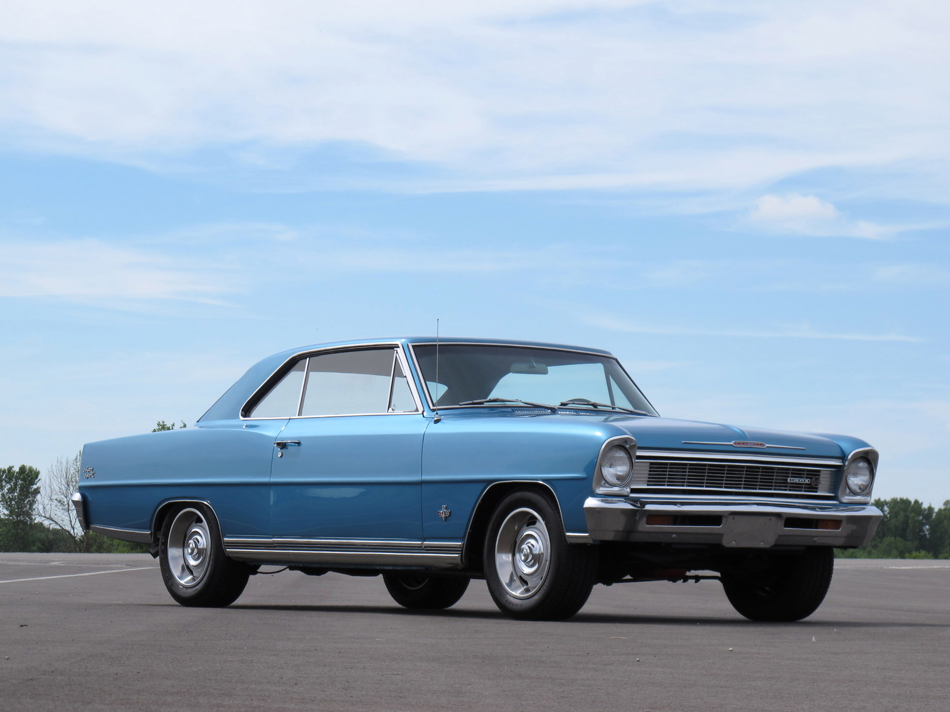
22
WHY GET INTO THIS TRICKY GAME?
GM exports of the Chevy Nova
Understand your customers
and their customs
No va translates in Spanish to not going
A critical market mistake due to not knowing the customer
22

Slide 23
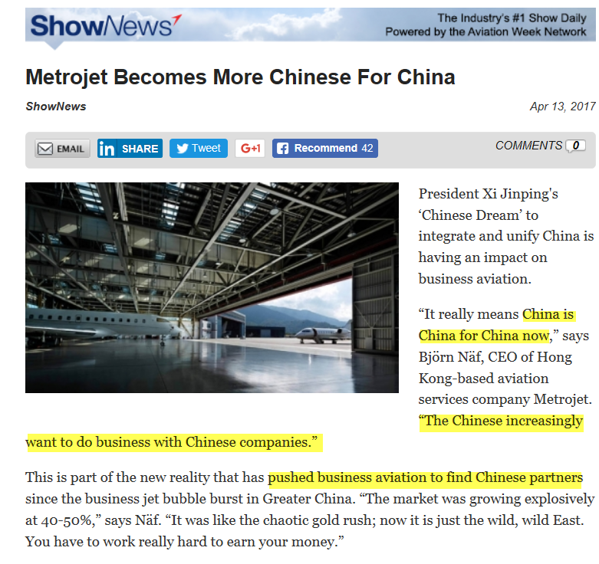
23
WHY GET INTO THIS TRICKY GAME?
The increasing growth of nationalism
China is China for
China
23

Slide 24
Parker Hannifin: a global importer - exporter
Chutes and ladders: the risks and opportunities of global trade
The current global trade environment
Why get into this tricky game?
Lessons learned
Tools for success
24

Slide 25
25
LESSONS LEARNED
Do your homework
KEY QUESTIONS
What products or services will I export?
To whom will I sell them?
What research do I need?
What is the business case?
What is my plan of attack?
What help do I need?
25

Slide 26
26
LESSONS LEARNED
Go straight to jail (laws/regulations)
Do the math! (financial sense)
Just do it! - NOT (strategy/plan/process)
My heart’s not in it! (commitment)
Can you hear me now? (cross-cultural
communications)
Why is this so hard? (patience/expectations)
Lawyer up! (legal)
Jump on the first horse! (partner effectively)
My eyes were bigger than my stomach! (focus)
What does all this mean? (big data, info overload)
Top 10
pitfalls to avoid
Adapted from Jim Mayfield, US Dept of Commerce
26

Slide 27
Parker Hannifin: a global importer - exporter
Chutes and ladders: the risks and opportunities of global trade
The current global trade environment
Why get into this tricky game?
Lessons learned
Tools for success
27

Slide 28
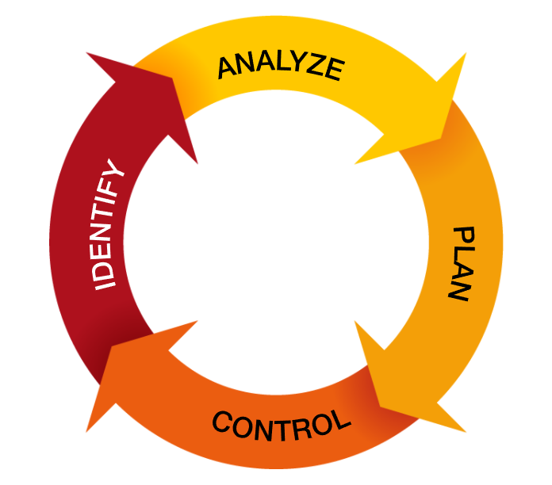
TOOLS FOR SUCCESS
DISCIPLINED
METHODOLOGY
Standard risk management process
28
Notes:
Identify
Strategy, Future State Visualization
Analyze
Does the data support my strategy and vision? (SWOT Analysis)
If not, adjust your strategy and vision to align
Plan
What are the specific tactical steps that you will need to take to reach my future state?
What help do you need?
Control
Is your plan meeting intermediate milestones?
If not, adjust the plan.

Slide 29

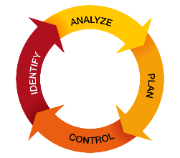
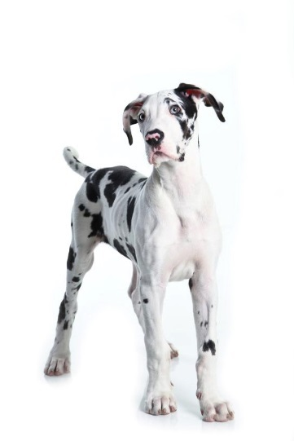
29
TOOLS FOR SUCCESS
IDENTIFY
Current state/future state definition
29

Slide 30







30
TOOLS FOR SUCCESS
STRENGTH
WEAKNESS
ANALYZE
SWOT analysis
Business case
OPPORTUNITIES
THREATS
30

Slide 31
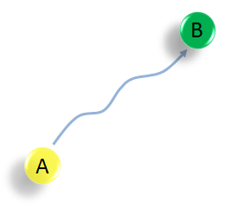
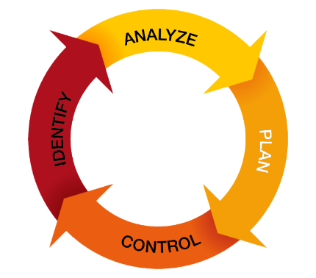
TOOLS FOR SUCCESS
PLAN
Detailed planning for
each step of the way,
with contingencies
defined ahead of time
“Plans are nothing.
Planning is everything.”
- Dwight D. Eisenhowser
31

Slide 32
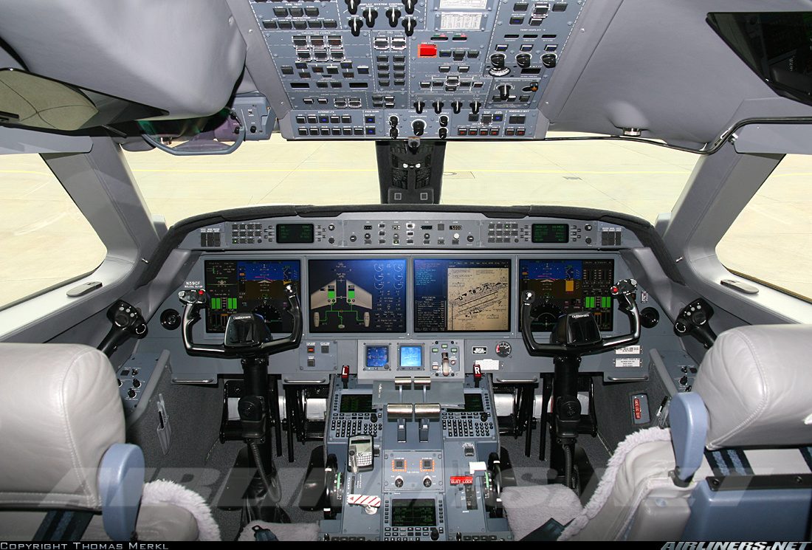
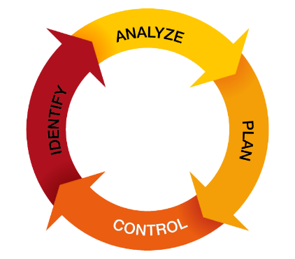
TOOLS FOR SUCCESS
CONTROL
How will you know if
you are on plan or not?
32

Slide 33
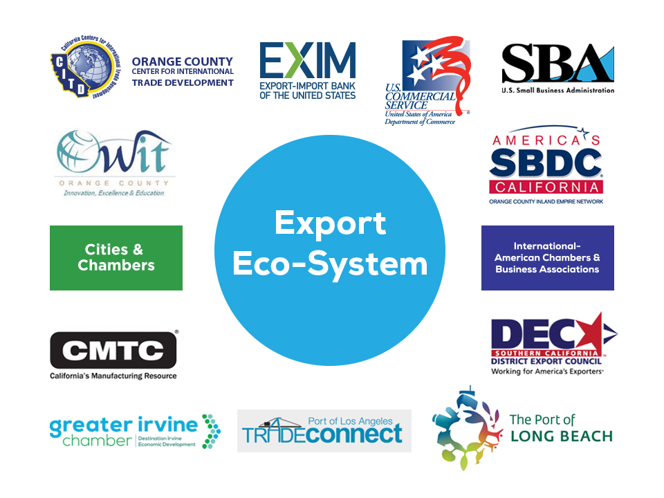
TOOLS FOR SUCCESS
RESOURCES
OC Chamber of Commerce
U.S. Department of Commerce
Additional sources
33

Slide 34
TOOLS FOR SUCCESS
CONTACTS
Orange County Center for International Trade Development |  | http://orangecountycitd.com/
Women in International Trade |  | http://witoc.org
California Manufacturing Technology Consulting |  | http://www.cmtc.com/
Greater Irvine Chamber |  | https://www.greaterirvinechamber.com/irvinechamber
Port of Los Angeles Trade Connect |  | http://www.latradeconnect.org/
Export - Import Bank of the United States |  | http://grow.exim.gov
U.S. Commercial Service |  | http://www.trade.gov/cs/
U.S. Small Business Adminstration |  | https://www.sba.gov/
America's SBDC California Orange County Inland Empire Network |  | http://www.leadsbdc.org/
DEC Southern California District Export Council |  | http://www.decsocal.org/
The Port of Long Beach |  | http://www.polb.com/
34

Slide 35

Summary and wrap up
Key take-aways
  Understand your motivations
  Develop a strategy and tactics
  Learn from others’ mistakes
  Get help
  Have fun and WIN!
35

Slide 36


